Slide 1
AWS VPC
PRESENTED BY :
MADHURI MUTHOLLA
EMPLOYEE ID : 46333985

Slide 2
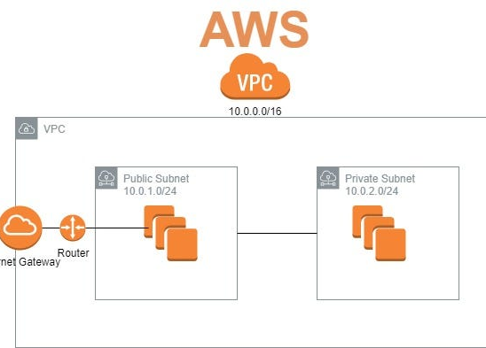
INTRODUCTION TO AWS VPC
AWS VPC stands for Amazon Virtual Private Cloud
It is a service provided by Amazon Web Services(AWS) that allows users to create their own isolated virtual network within the AWS cloud infrastructure.

Slide 3
Benefits of using VPC
Enhanced security and isolation of resources from the public internet
Flexibility to configure network settings, including IP addresses, routing tables and network gateways
Scalability to accommodate growth and changes in the network requirements

Slide 4
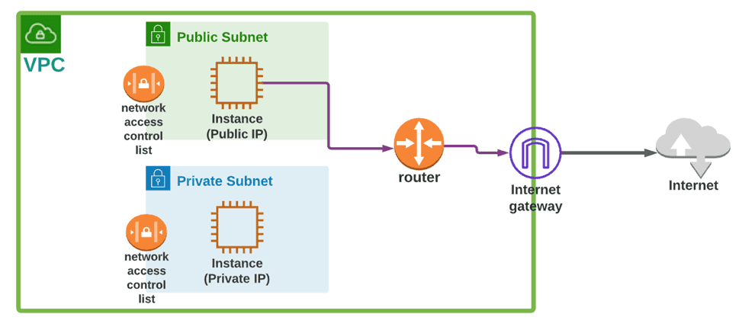
VPC COMPONENTS

Slide 5
Creating VPC
Navigate to the VPC Dashboard in the AWS Management Console
1
Click on the “Create VPC” button
2
Enter a name in CIDR block for your VPC
3
Choose your tenancy option
4
Click on the “Create VPC” button to create your VPC
5

Slide 6
CONCLUSION
In conclusion, AWS VPC provides a secure and scalable way to manage your network infrastructure in the cloud with customizable security and flexible networking options, VPC can meet the needs of any organization, whether you are just starting out with cloud computing or looking to optimize your existing infrastructure.

Slide 7
THANK YOU

